Slide 1




Feeding Machine Learning Algorithms with Massive Model Suites
Leo Portes^{1,2}, Mark Jessell^{1,2,3}, Mark Lindsay^{2,4}, Guillaume Pirot^{1,2,3}, Michel Nzikou^{1,3}, Ed Cripps^{1,2}
¹UWA, ²ITTC DARE, ³MinEx CRC, ⁴CSIRO

Slide 2

Agenda
Background: Noddy & Guo et al, 2021
High dimensionality: Haralick features
Exploring separability
Simpler ML architectures
SVM, KNN, RF, NN
Geological Interpretation (hands-on, 3-4 pm )
Current and future work
Real-world data
NoddyVerse with 343 classes and 310K data points (hands-on, 3-4 pm)
“Maths”+Theory

Slide 3
Background
Noddy & Guo et al 2021

Slide 4
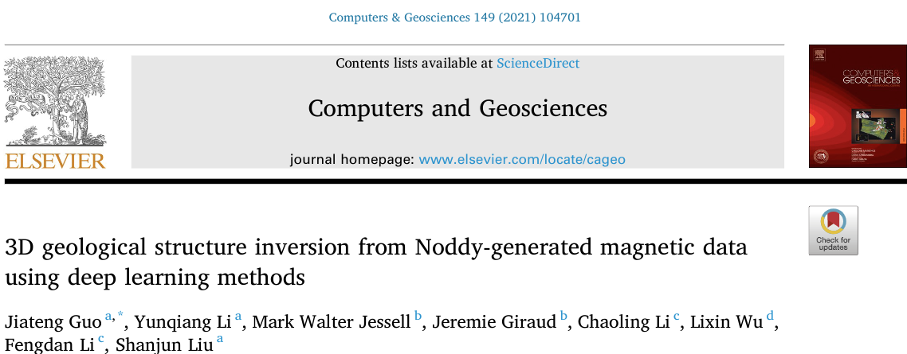
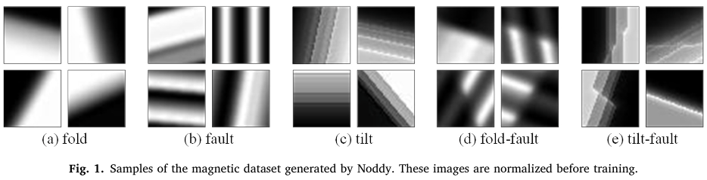
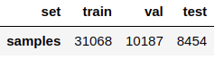
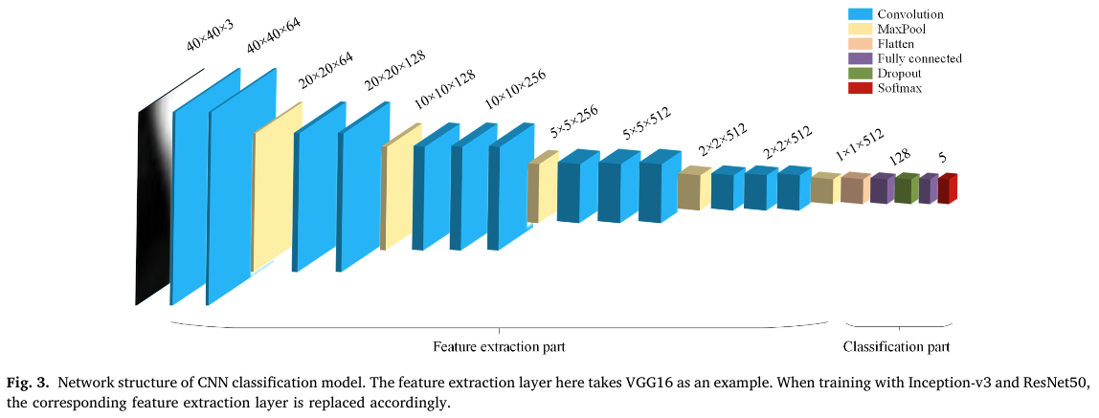
Goal: predict the parameters of the geological structure:
“a” - dip direction
“b” - dip angle of the fold axial surface
Magnetic field 2D images
Noddy dataset, ~50k samples
Classifier
Inception-v3
(very deep) CNN
Reg-1
Inception-v3
Reg-2
Inception-v3
Reg-5
Inception-v3
...
(a₁, b₁)
(a₁, b₁)
(a₁, b₁, a₂, b₂)
Guo et al, 2021

Slide 5
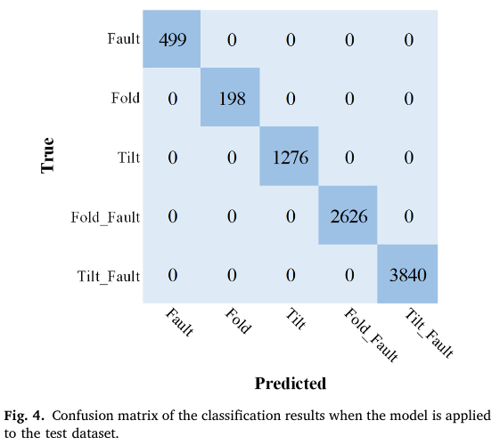
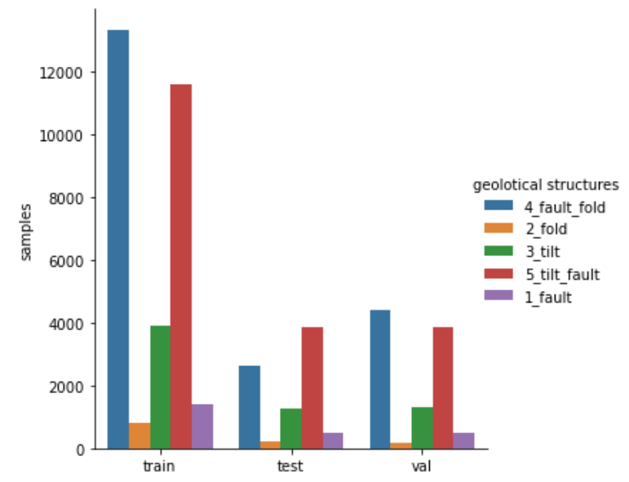
Guo’s classifier
class distribution
Magnetic field 2D images
Noddy dataset, ~50k samples
Guo et al, 2021

Slide 6
Current work
Guo et al 2021
Current work
Magnetic field 2D images
Noddy dataset, ~50k samples
Magnetic field 2D images
Noddy dataset, ~50k samples
Classifier
Inception-v3
(very deep) CNN
Feature Engineering
(eg, Haralick Features)
Explore
Separability in H-space
Geological meaning
"Diversity" (uncertainty?)
Classifier
simpler architectures
& more
Reg-1
Inception-v3
Reg-2
Inception-v3
...
Reg-5
Inception-v3
3D geo-pam
3D geo-pam
3D geo-pam

Slide 7
High dimensionality
Haralick Features

Slide 8

High dimensionality | encoding through texture features
Geophysics
mD vector
tilt_fault
[f₁, f₂, …, f_{m}]
NxN → m, m << N²
What can we explore and expect to achieve?
Separability
Geological meaning
"Diversity" (class hierarchy?)
Uncertainty
Simpler ML architectures: SVM, KNN, RF
Tasks: classification, regression (parameter extraction), feature ranking
Scalabitliy (>>50k samples, less time/memory)
Interpretability, explainability

Slide 9

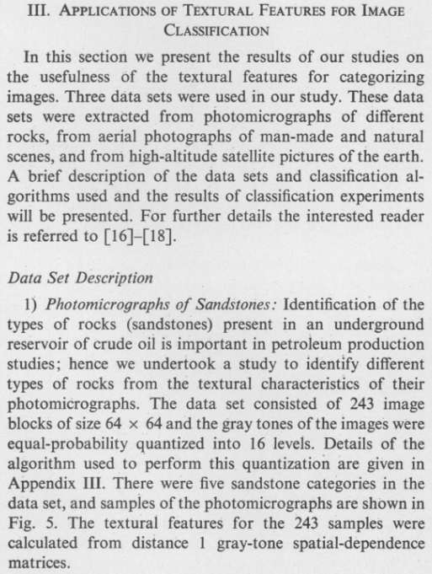
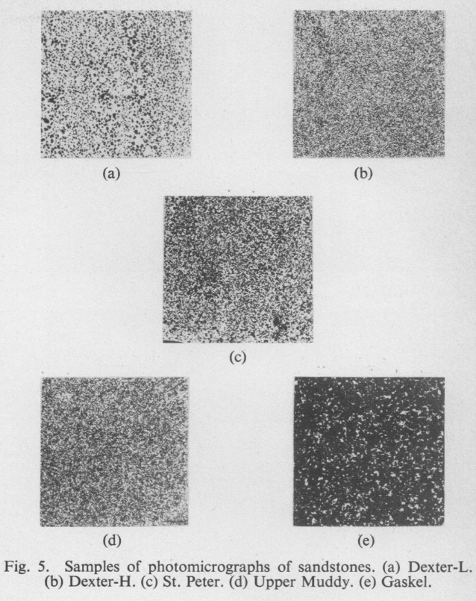
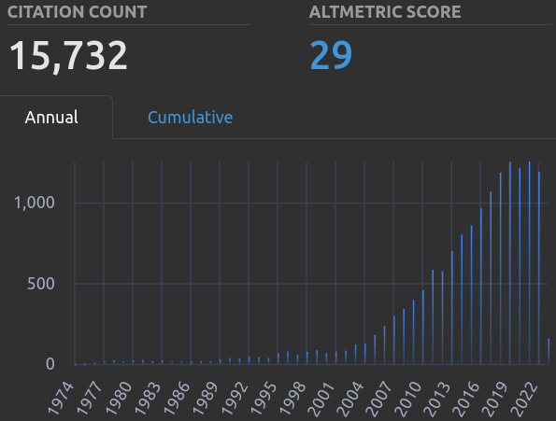
High dimensionality | encoding through texture features
Geophysics
mD vector
Grey Level Co-occurrence Matrix
tilt_fault
[f₁, f₂, …, f₁₃]
40x40 → 13, 13 << 1600
Haralick et al, 1973

Slide 10
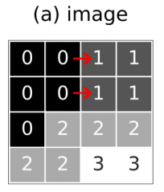
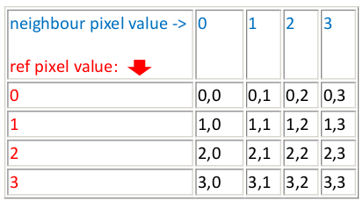
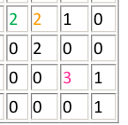
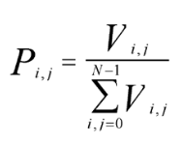
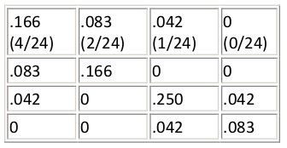
Grey Level Co-occurrence Matrix
Example: right (east) spatial relationship
Image
Framework matrix
GLCM
(normalized) GLCM
(normalized) GLCM ~ Joint probability distribution of two pixels having the same grey level
Hall-Beyer, 2007. GLCM Texture: A Tutorial v. 1.0 through 2. http://hdl.handle.net/1880/51900

Slide 11
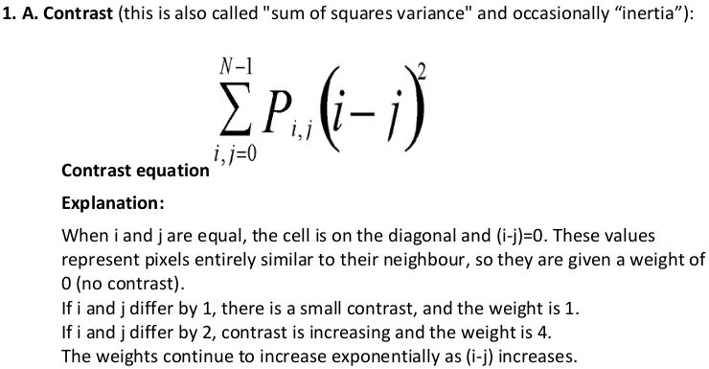
Texture measures (features)
Summarize the GLCM in helpful ways
Several of them (13-17?): allows choice to fit the problem at hand
Most of them are weighted averages of the GLCM
Hall-Beyer, 2007. GLCM Texture: A Tutorial v. 1.0 through 2. http://hdl.handle.net/1880/51900

Slide 12

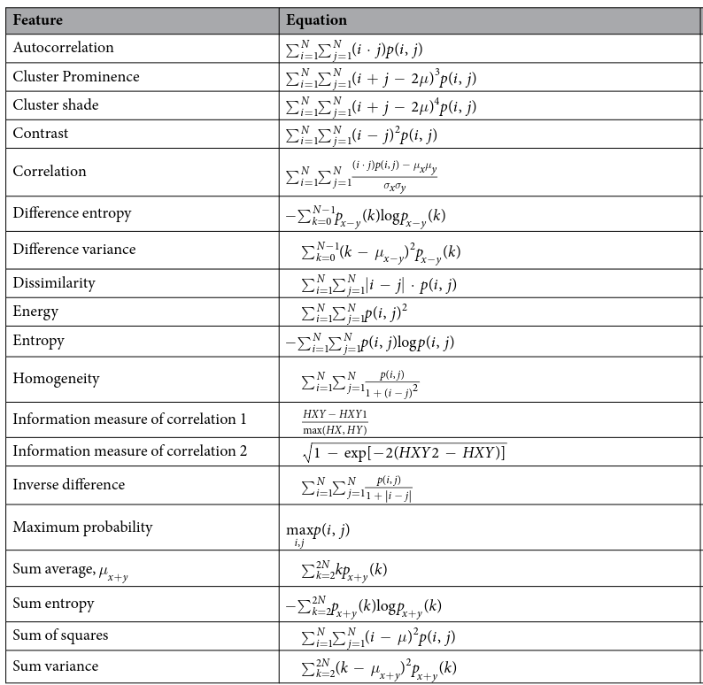
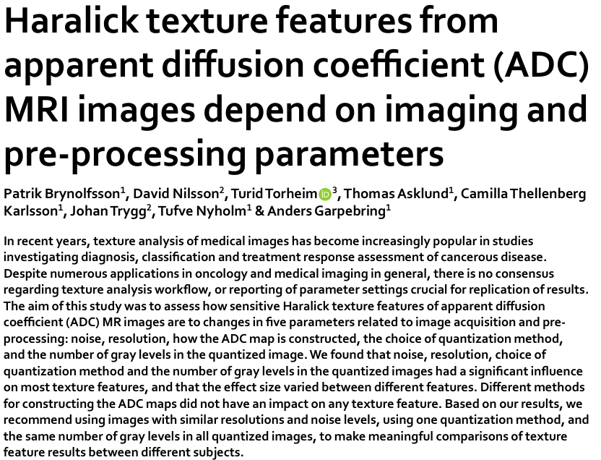
Brynolfsson et al, 2017

Slide 13
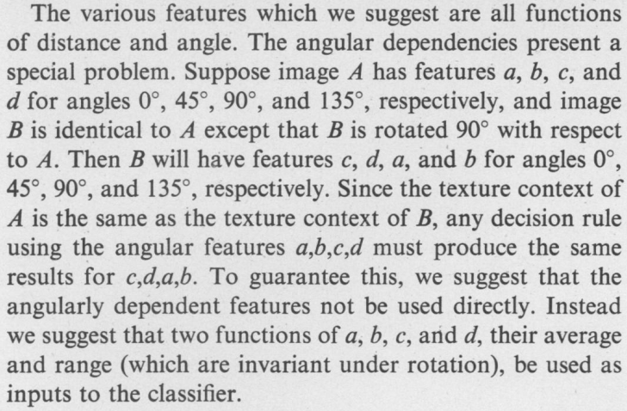

Rotational “invariance”
Right → Horizontal
A_{horizontal} = A + A^{T}
f_{horiz}= [f₁, f₂, …, f₁₃]
Haralick et al, 1973

Slide 14
Images → feature vectors
Right → Horizontal
4 Directions
4 GLCM in total
4x13 features
Average of all directions → approximate rotational invariant feature
A_{horizontal} = A + A^{T}
90º
f₀= [f₁, f₂, …, f₁₃]
135º
45º
f₄₅= [f₁, f₂, …, f₁₃]
0º
f₉₀= [f₁, f₂, …, f₁₃]
f_{horiz}= [f₁, f₂, …, f₁₃]
f₁₃₅= [f₁, f₂, …, f₁₃]
f_{av}= [<f₁>_{av}, …, <f₁₃>_{av}]

Slide 15



High dimensionality | encoding through texture features
40x40 → 13, 13<< 1600
List of features used
1. ASM, Angular second moment
2. Contrast
3. Correlation
4. SSV, Sum of squares: variance
5. IDM, Inverse difference moment
6. SA, sum average
7. SV, sum variance
8. Sum Entropy
9. Entropy
10. DF, Difference variance
11. DE, Difference Entropy
12. and 13, Information Measures correlations:
* HXY1
* HXY2
ASM
Contrast
HXY2
Geophysics
tilt_fault
[0.00101, 332.10, …, 0.999884]
tilt_fault
[0.00212, 212.44, …, 0.999868]
fault_fold
[0.00298, 84.02, …, 0.999728]
...
tilt_fault
[0.00101, 332.08, …, 0.999885]
Higher similarity
Files:
300_090_240_030
340_030_340_040
140_060_140_070
060_090_300_030

Slide 16
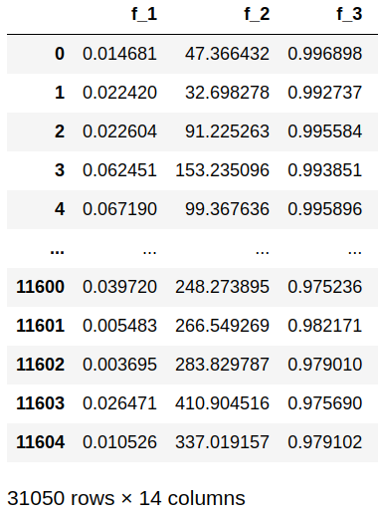
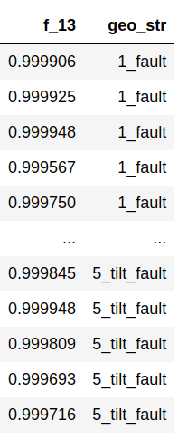
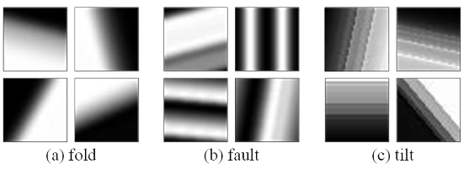
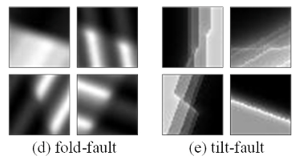
And now… What?
2D mag responses
New representation
...
...
...
We now have a 13D space to represent the geophysics. Is it meaningful?
Data separability?
Simpler ML architectures?
13D space has a geological interpretation?
Projection of real-world data?

Slide 17
Exploring separability
(in the “Haralick space”)

Slide 18
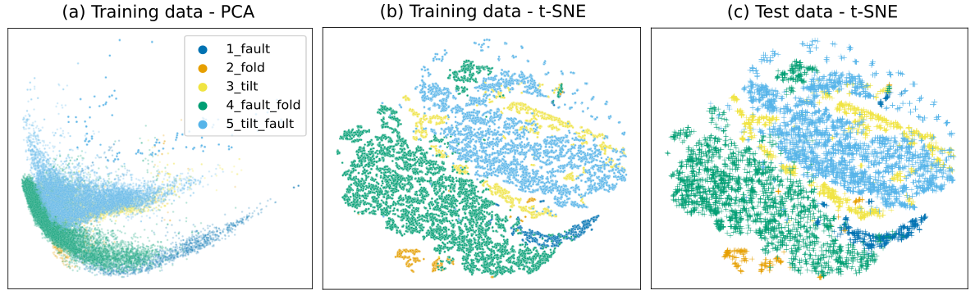
Exploring separability
class distribution
Magnetic field 2D images
Noddy dataset, ~50k samples

Slide 19

Exploring separability
t-SNE projection
(t-distributed stochastic neighbor embedding)
Other possible options*: Uniform Manifold Approximation and Projection (UMAP), Multidimensional scaling (MDS), Self-organizing map (SOM)
* and 22 others at Wikipedia
* Van der Maaten, Laurens, and Geoffrey Hinton. Visualizing data using t-SNE. Journal of machine learning research 9, no. 11 (2008).
* Kobak, D. & Berens, P. The art of using t-SNE for single-cell transcriptomics. Nat Commun 10, 5416 (2019).

Slide 20
Exploring separability

Slide 21
Exploring separability

Slide 22
Simpler ML architectures
SVM, KNN, Random Forest

Slide 23
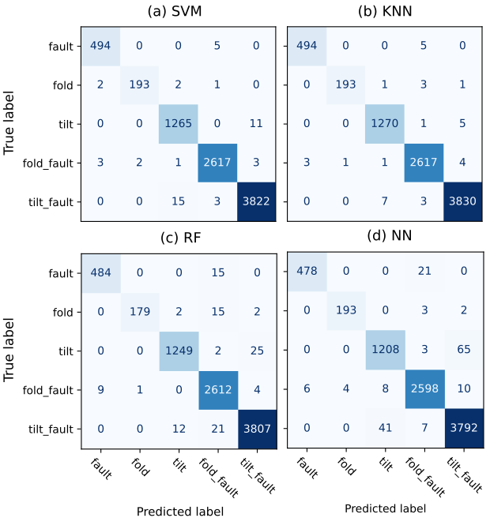
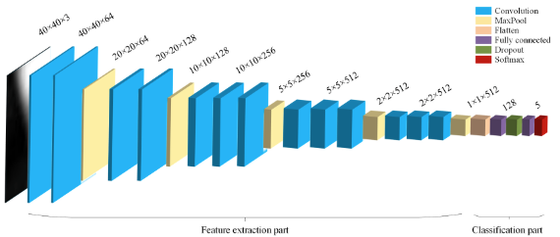
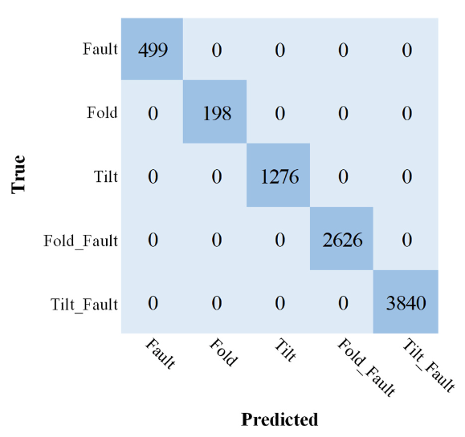
Classification | “Simple” ML architectures
Guo et al, 2021
Notes:
23

Slide 24
Geological Interpretation
(More @ 3-4 pm, NoddyVerse demo!)

Slide 25
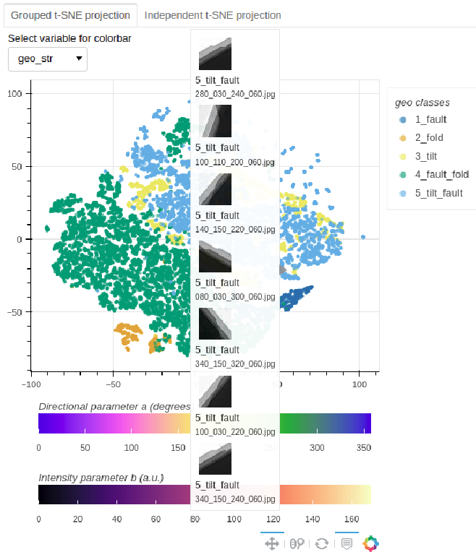
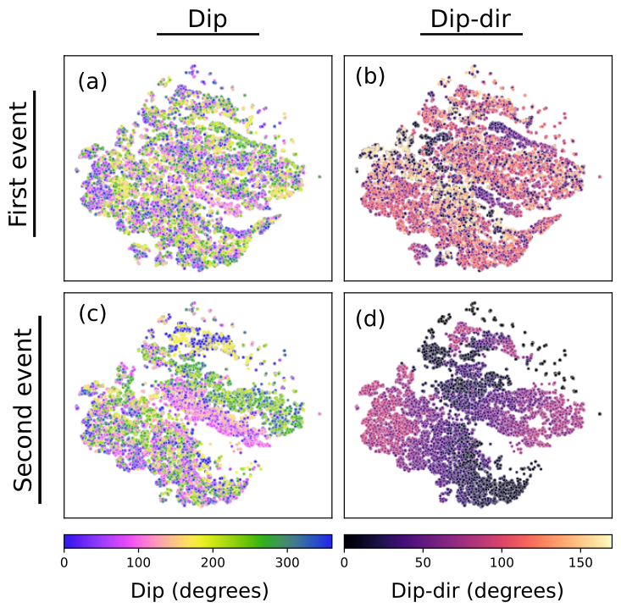
Geological Interpretation
(More @ 3-4 pm, NoddyVerse demo!)
http://13.211.217.129/6IAS/integrated-data-vis%202.html
Notes:
25

Slide 26

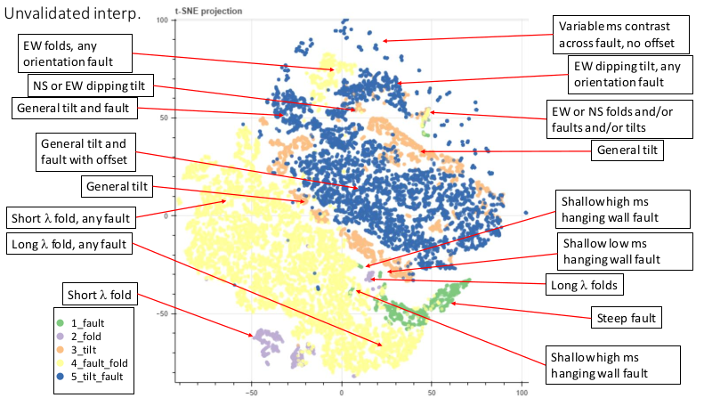
Geological Interpretation
Steep Fold Axial Plane
Shallow Fold Axial Plane
Notes:
26

Slide 27
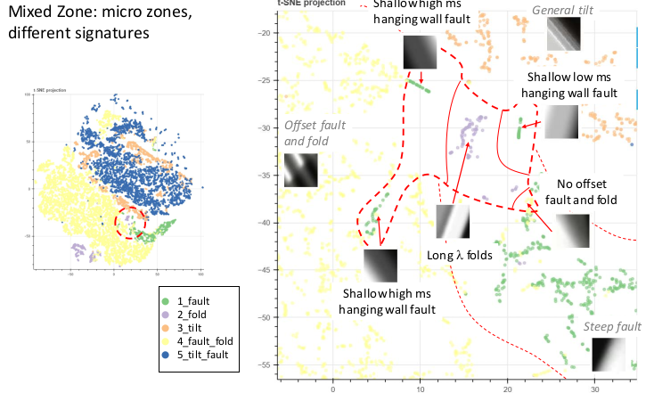
Geological Interpretation
Notes:
27

Slide 28
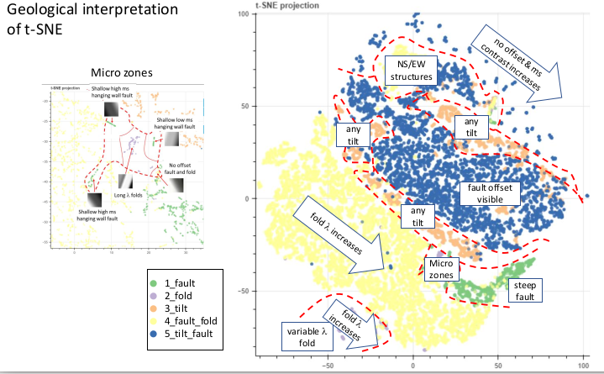
Geological Interpretation
Fold axial plane shallows
Notes:
28

Slide 29
Current and future work
Real-world data
Projection
NoddyVerse dataset (hands-on)
343 classes and 310K data points
“Maths”+Theory
Optimal (hyper) parameters, features and the curse of dimensionality

Slide 30
Current and future work
Real-world data
Projection
NoddyVerse dataset
343 classes and 310K data points
“Maths”+Theory
Optimal (hyper) parameters, features and the curse of dimensionality

Slide 31
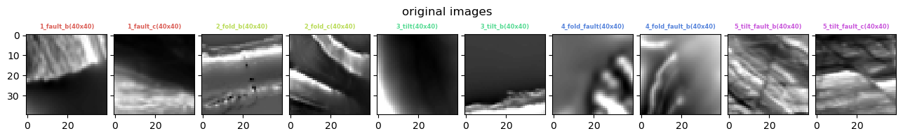
Rear-world data provided by an expert
Manually classified
Two instances for each of the five classes investigated by Guo 2021, with similar geological scale
Pre-processing: 600x600 → 40x40; Haralick features with distance = 1
Notes:
31

Slide 32
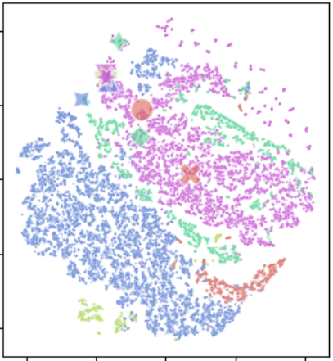
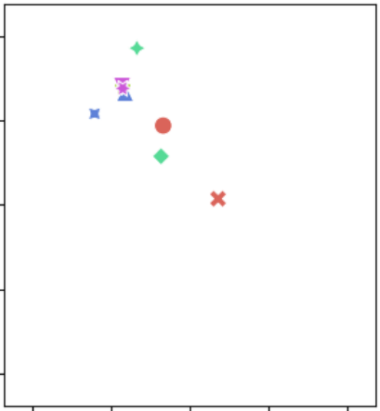
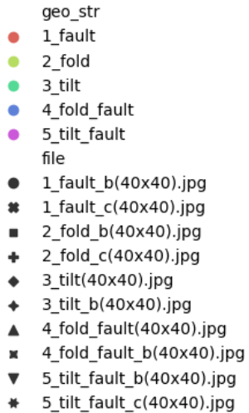
T-SNE | training data & projected new instances
Notes:
32

Slide 33
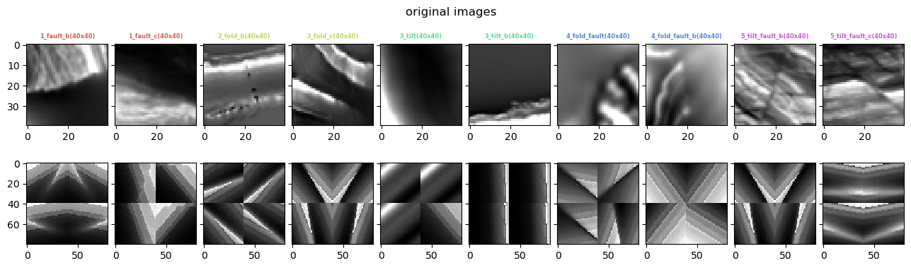
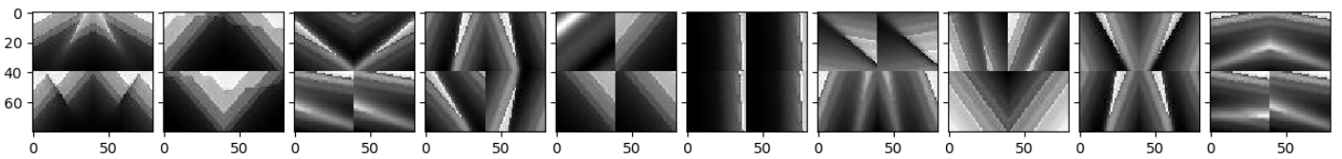
Four nearest neighbors (t-sne 2d-space and original 13d space)
Test
t-SNE
4 Neighbours
13D
Notes:
33

Slide 34
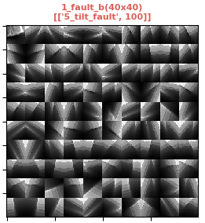
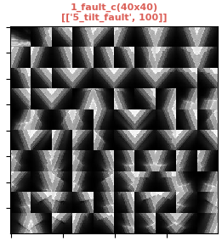
1st tile is the test image (t-SNE neighbours)
Notes:
34

Slide 35
Current and future work
Real-world data
Projection
NoddyVerse dataset (hands-on)
343 classes and 310K data points
“Maths”+Theory
Optimal (hyper) parameters, features and the curse of dimensionality

Slide 36
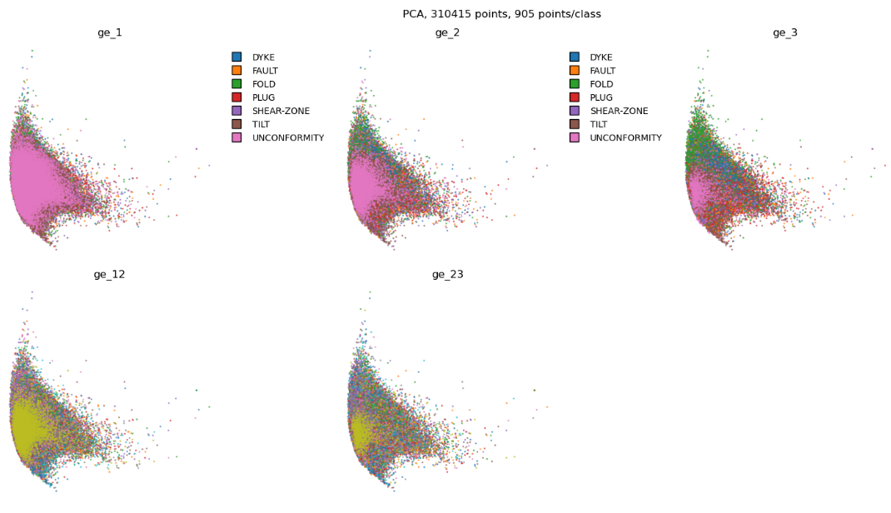
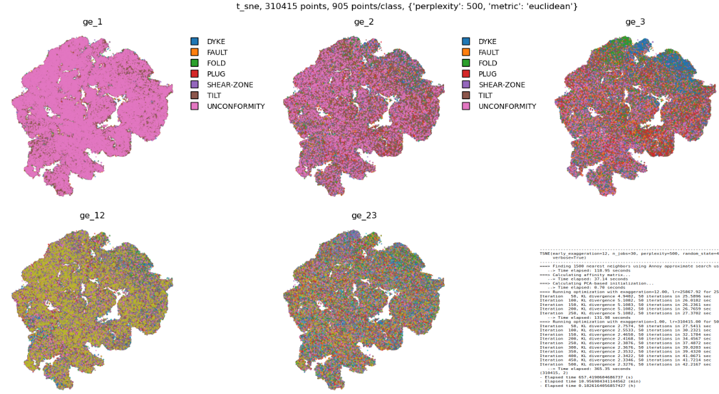
343 classes and 310K data points…
Encoded into only 13 dimensions...
Visualized in only 2 dimensions...
Geological event history [E1, E2, E3] → color by E_{i} class
PCA
t-SNE

Slide 37
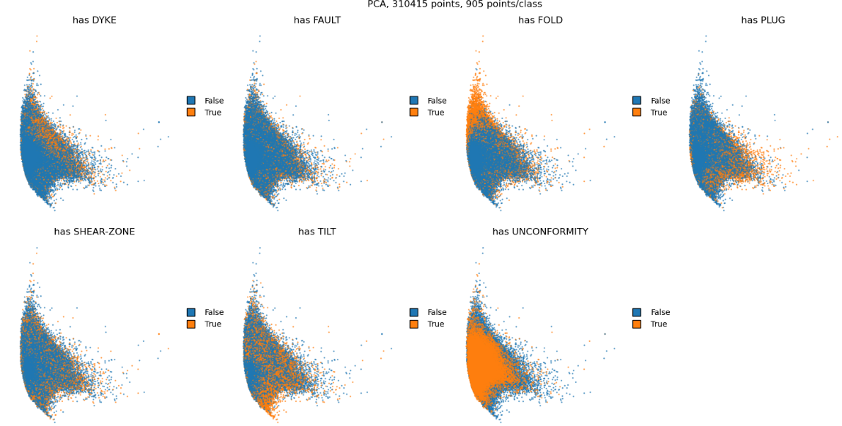
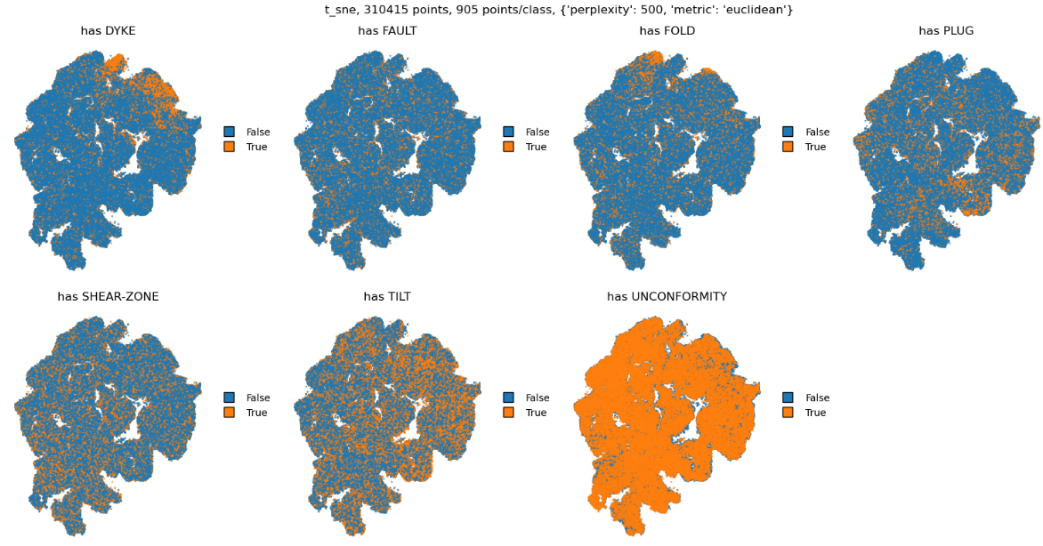
343 classes and 310K data points…
Encoded into only 13 dimensions...
Visualized in only 2 dimensions...
Geological event history [E1, E2, E3] has event X?
PCA
t-SNE

Slide 38
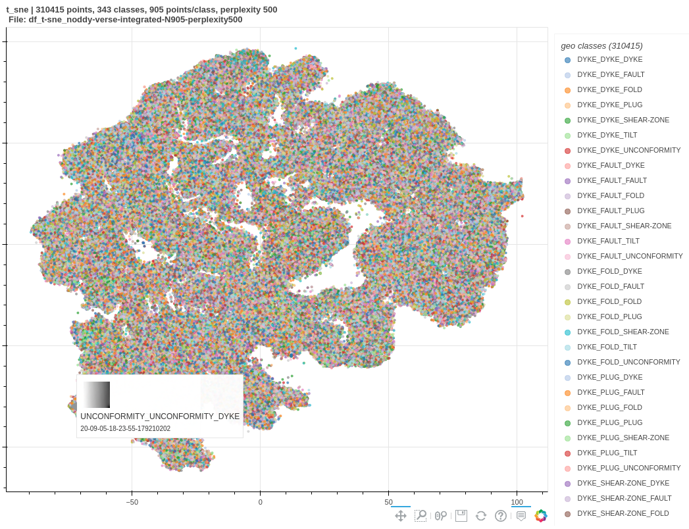
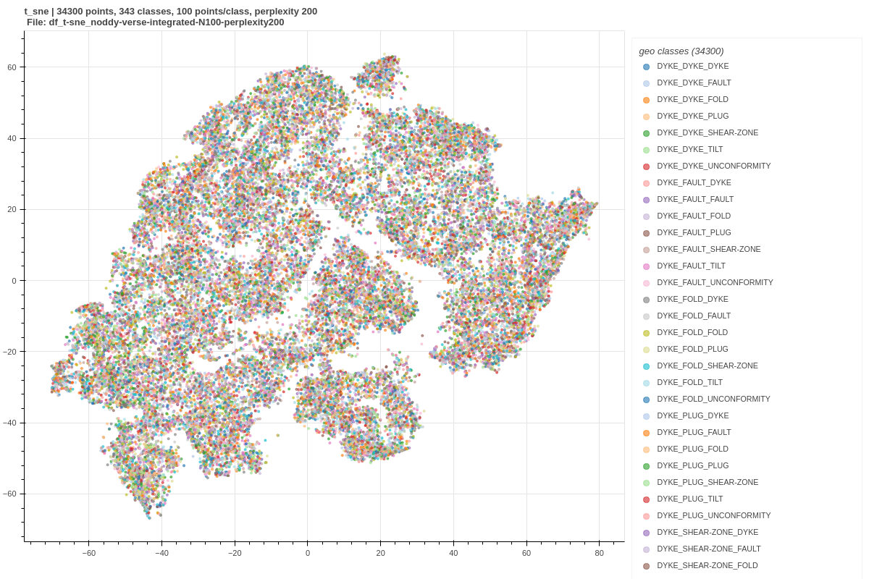
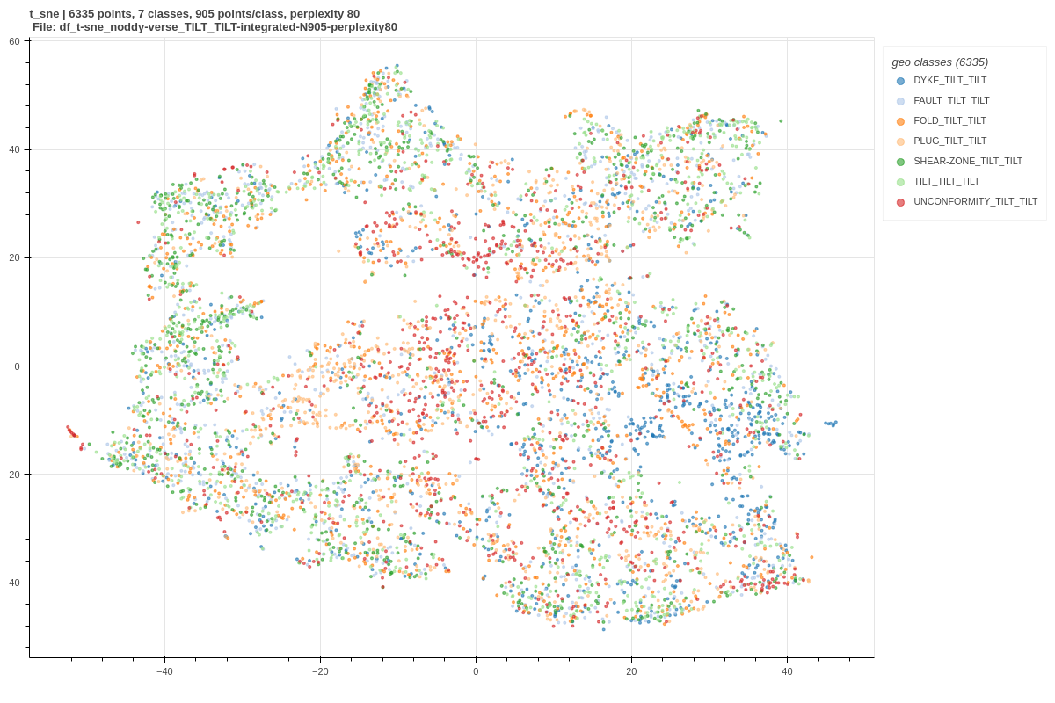
343 classes and 310K data points…
Encoded into only 13 dimensions...
Visualized in only 2 dimensions...
Hands-on
3-4 pm session
100 samples/class
Only [X, TILT, TILT]

Slide 39
Current and future work
Real-world data
Projection
NoddyVerse dataset
343 classes and 310K data points
“Maths”+Theory
Optimal (hyper) parameters, features and the curse of dimensionality

Slide 40
“Maths”+Theory
Auto-correlation function
- Haralick’s distance parameter optimal value ↔ scale of geological features
Adding/removing features to the embedding vs the curse/blessing of dimensionality
- Bespoke features
- Removing correlated features
- Other encoding (e.g., Fisher vector feature encoding)
- Data integration → Mag and Grav responses (26D space!)
Advanced t-SNE approaches
- Initializing via down sampling
- Perplexity annealing
Other non-liner projections?
- Uniform Manifold Approximation and Projection (UMAP), Multidimensional scaling (MDS),
Self-organizing map (SOM)

Slide 41
REFERENCES
Jessell, M. et al. Into the Noddyverse: a massive data store of 3D geological models for machine learning and inversion applications. Earth Syst Sci Data 14, 381–392 (2021).
Guo, J. et al. 3D geological structure inversion from Noddy-generated magnetic data using deep learning methods. Comput Geosci 149, 104701 (2021).
Haralick, R. M. Statistical and structural approaches to texture. P IEEE 67, 786–804 (1979).
Haralick, R. M., Shanmugam, K. & Dinstein, I. Textural Features for Image Classification. IEEE Transactions Syst Man Cybern SMC-3, 610–621 (1973).
Brynolfsson, P. et al. Haralick texture features from apparent diffusion coefficient (ADC) MRI images depend on imaging and pre-processing parameters. Sci Rep-uk 7, 4041 (2017).
Hall-Beyer, 2007. GLCM Texture: A Tutorial v. 1.0 through 2.7. http://hdl.handle.net/1880/51900
Van der Maaten, Laurens, and Geoffrey Hinton. Visualizing data using t-SNE. Journal of machine learning research 9, no. 11 (2008).
Kobak, D. & Berens, P. The art of using t-SNE for single-cell transcriptomics. Nat Commun 10, 5416 (2019).
Gorban, A. N., Tyukin, I. Y. Blessing of dimensionality: mathematical foundations of the statistical physics of data. Philosophical Transactions Royal Soc Math Phys Eng Sci 376, 20170237 (2018).
Köppen, M. The curse of dimensionality. in 5th online world conference on soft computing in industrial applications (WSC5) vol. 1 4–8 (2000).

Slide 42

THANK YOU!
Contact
Leonardo Portes
ll.portes@gmail.com
Notes:
42

Slide 43
Notes:
43

Slide 44
Notes:
44

Slide 45
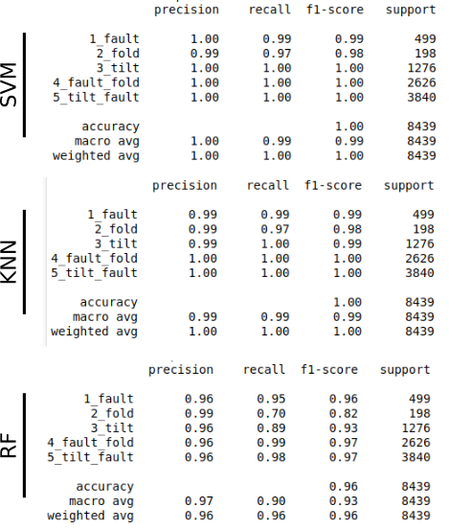
Haralick Features | Classifiers

Slide 46
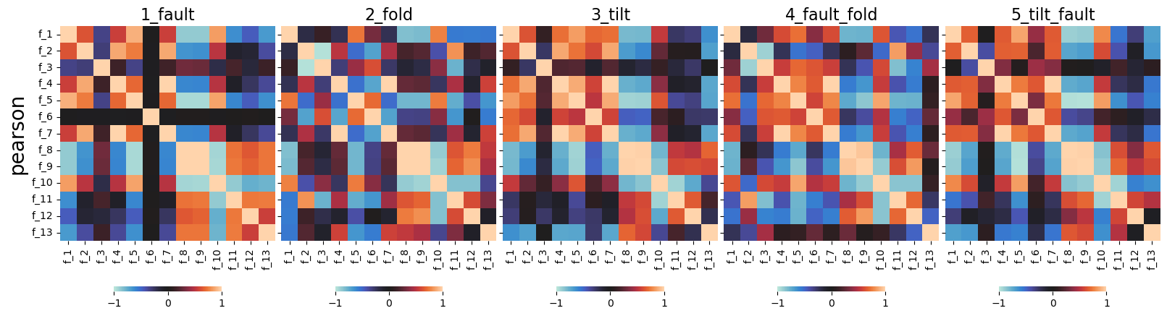
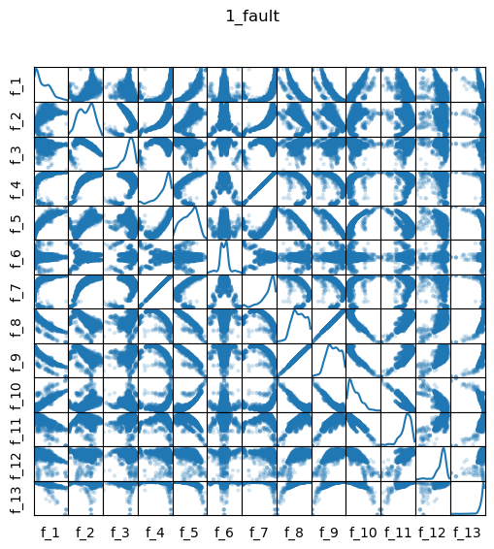
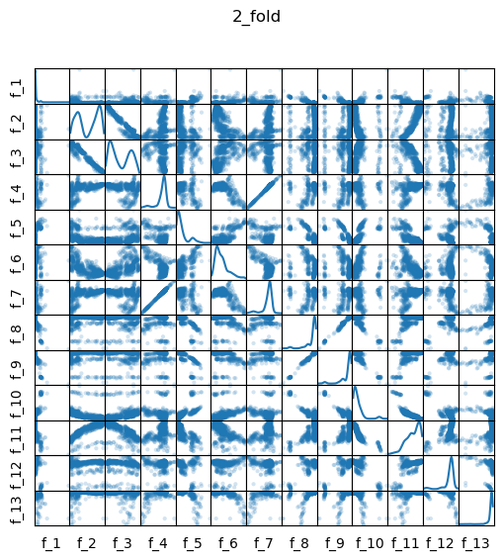



Haralick Features | Correlation
simetry
mirror

Slide 47



Haralick Features | Ranking
Pitfalls:
* imbalanced data
* importance related to classification task
notebooks/1.HaralickFeatures/2c.RF-training2022-08-17.ipynb#

Slide 48









